Slide 1
Seaborn
Musadaq Mansoor

Slide 2
Data Visualization
Data Visualization is the presentation of data in pictorial format. It is extremely important for Data Analysis, primarily because of the fantastic ecosystem of data-centric Python packages. And it helps to understand the data, however, complex it is, the significance of data by summarizing and presenting a huge amount of data in a simple and easy-to-understand format and helps communicate information clearly and effectively.

Slide 3
Seaborn
Seaborn is an amazing visualization library for statistical graphics plotting in Python. It is built on the top of matplotlib library and also closely integrated into the data structures from pandas.

Slide 4
Installation
For python environment :
pip install seaborn
For conda environment :
conda install seaborn

Slide 5
Loading Data
import pandas
# load the csv
data = pandas.read_csv("nba.csv")
# show first 5 column
data.head()

Slide 6
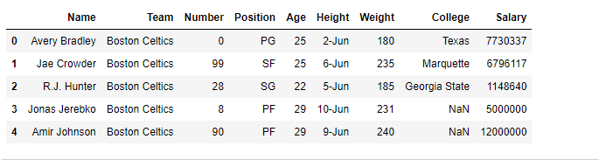

Slide 7
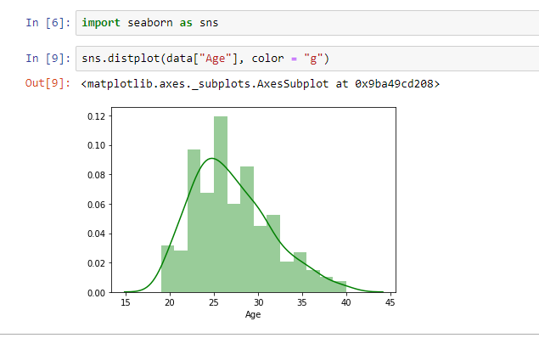

Slide 8
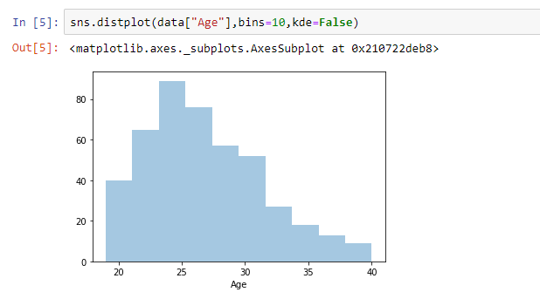

Slide 9
Lineplot
Lineplot Is the most popular plot to draw a relationship between x and y with the possibility of several semantic groupings.
Syntax : sns.lineplot(x=None, y=None)
Parameters:
x, y: Input data variables; must be numeric. Can pass data directly or reference columns in data.

Slide 10
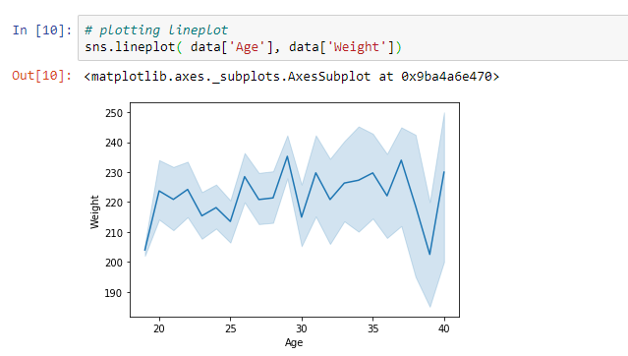

Slide 11
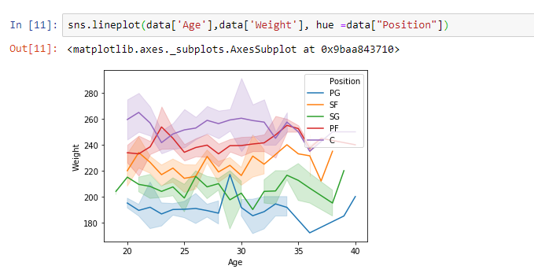

Slide 12
Scatterplot
Scatterplot Can be used with several semantic groupings which can help to understand well in a graph against continuous/categorical data. It can draw a two-dimensional graph.
Syntax: seaborn.scatterplot(x=None, y=None)
Parameters:
x, y: Input data variables that should be numeric.

Slide 13
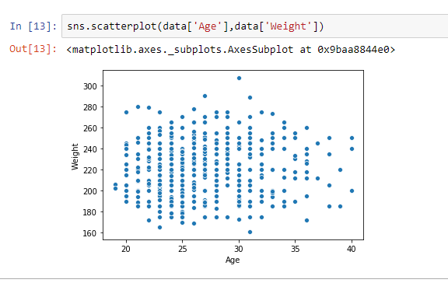

Slide 14
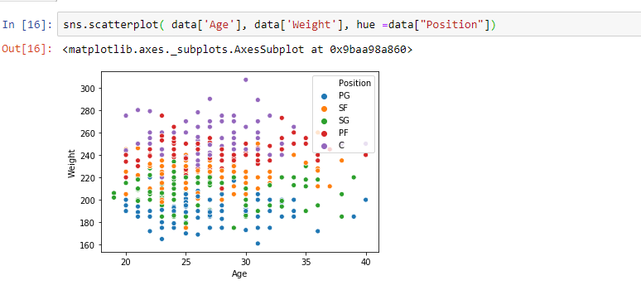

Slide 15
Box plot
A box plot (or box-and-whisker plot) s is the visual representation of the depicting groups of numerical data through their quartiles against continuous/categorical data.
Syntax:
seaborn.boxplot(x=None, y=None, hue=None, data=None)
Parameters:
x, y, hue: Inputs for plotting long-form data.
data: Dataset for plotting. If x and y are absent, this is interpreted as wide-form.
Returns: It returns the Axes object with the plot drawn onto it.

Slide 16
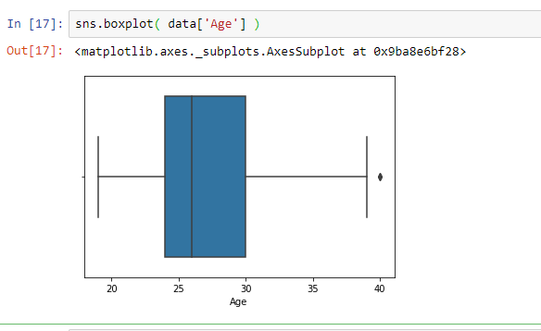

Slide 17
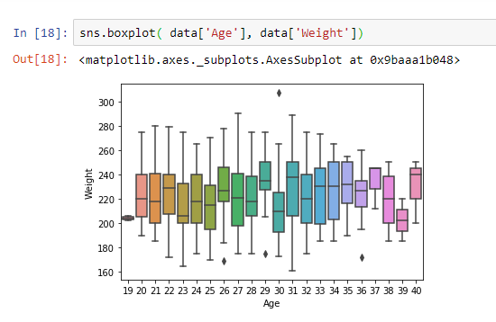

Slide 18
Violin Plot
A violin plot is similar to a boxplot. It shows several quantitative data across one or more categorical variables such that those distributions can be compared.
Syntax: seaborn.violinplot(x=None, y=None, hue=None, data=None)
Parameters:
x, y, hue: Inputs for plotting long-form data.
data: Dataset for plotting.

Slide 19
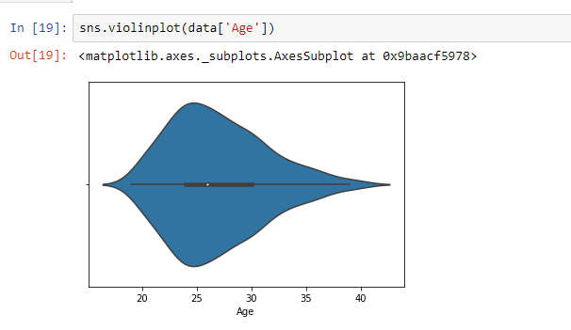

Slide 20
Count plot
Count plot used to Show the counts of observations in each categorical bin using bars.
Syntax : seaborn.countplot(x=None, y=None, hue=None, data=None)
Parameters :
x, y: This parameter take names of variables in data or vector data, optional, Inputs for plotting long-form data.
hue : (optional) This parameter take column name for color encoding.
data : (optional) This parameter take DataFrame, array, or list of arrays, Dataset for plotting. If x and y are absent, this is interpreted as wide-form. Otherwise, it is expected to be long-form.

Slide 21
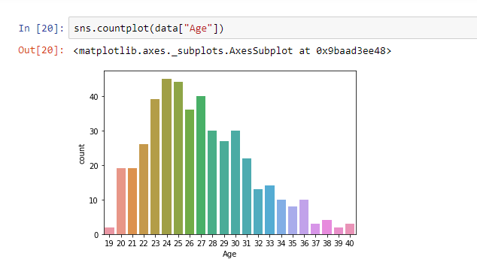

Slide 22
